Slide 1
Agglomerative Clustering
What is agglomerative clustering:
Gaussian Mixture Model (GMM) is a probabilistic clustering technique that models data as a combination of multiple Gaussian distributions, allowing more flexible grouping of data points.
Analogy: Imagine you’re at a fruit market:
Some baskets have apples, some oranges, some bananas.
But the fruits are mixed together on the table.
Instead of hard‑splitting them (like K‑Means), you say: “This fruit is 70% apple‑like, 30% orange‑like.” That’s what GMM does — it gives probabilistic cluster membership instead of rigid assignments.

Slide 2
When to Use
When clusters may overlap.
When you want probabilistic membership instead of hard labels.
When data is assumed to follow a normal distribution within clusters.
Useful in speech recognition, anomaly detection, image segmentation.
Step‑by‑Step Process
Choose number of components (clusters).
Initialize Gaussian parameters (means, covariances, weights).
Expectation step: Compute probability each point belongs to each Gaussian.
Maximization step: Update parameters to maximize likelihood.
Iterate until convergence.
Assign clusters based on highest probability (or keep probabilities for soft clustering).

Slide 3
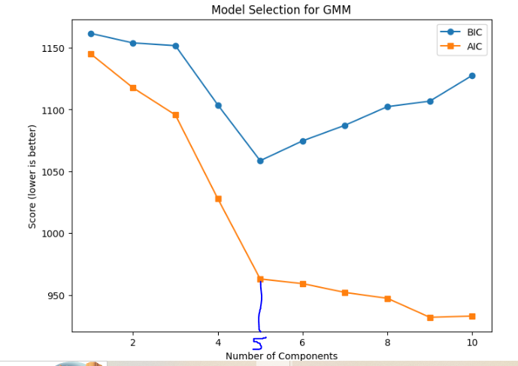
AIC/BIC diagram to decide n_components (natural groupings)

Slide 4
